Slide 1

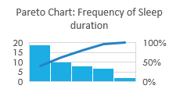
Impact of Daily Habits on Sleep
Process owner: Nick Waine
Key Dates --->
Data collection
Begins: 4/14/21
Define:
4/13/21
Measure
Analyze:
5/30/21
Improve
Control
DEFINE
MEASURE
ANALYZE
IMPROVE
Problem Statement: How do my daily behaviors affect my sleep? I am seeking optimal levels of calorie intake, ounces of coffee consumed, exercise, and productivity for maximum sleep.
We understand the equation for sleep, with Sleep being the Output value (Y), as:
Sleep = α + Calories + Coffee Intake + Exercise Level + Productivity
Reduce or eliminate coffee/
Caffeine altogether!
Identify more defect areas in process!
Perform controlled experiments (how can I determine what the causes are if all factors are constantly changing?)
SQL: 2.08
?
CONTROL
One important finding from this study is that I need to identify more areas of defect. A sleep score of under 6.5 hours results in a complete process failure, so identifying other possible defects within a system could yield a more accurate or revealing SQL score.
Attempt a consistent calorie intake while
regulating amount of caffeine consumed,
using insight gained from experiment in
eating a consistent number of calories each
day.
Controlled studies on exercise and calorie
intake will be crucial to better understand
how my body uses those factors for sleep.
No positive relationship observed between coffee consumption and productivity!
Data points collected are continuous
(sleep, coffee, calories), and ordinal
categorical data (productivity and exercise levels).
TEAM MEMBERS
Nick Waine

Slide 2
Sigma quality level: Defining a defect
My goal is to measure the capability of the process that results in my level of sleep.
A defect in this case is sleeping for under 6.5 hours. Research for my age and level of activity, 6.5 hours of sleep per night is the minimum healthy level I should be obtaining.
Of the 46 observations (nights of sleep) in the current process, 13 defects were noted, for a ratio of 0.282, or 282,000 DPMO.
SQL: 2.08

Slide 3
Data measurement plan
Performance Measure | Data Source & location | How will data be collected | Who will collect | When will data be collected | Target Sample Size
Sleep | Data to be collected by Withings HR Steel Sleep tracking watch and recorded in iPhone app, where data will be retrieved | Each morning I will view results shown in the Withings Health Mate app | To be collected by me | Daily, in morning | 50 days
Calories | Food items consumed will be searched and logged in MyFitnessPal app on iPhone | Calories will be tracked via MyFitnessPal app | To be collected by me | End of day | 50 days
Coffee consumed | To be collected and recorded manually | I will note amount of coffee consumed depending on standard size of cup used | To be collected by me | End of day | 50 days
Exercise Level | Data to be collected by Withings HR Steel fitness watch and recorded in iPhone app, where data will be retrieved | I will use data from Withings Health Mate app to view calories burned | To be recorded by me | End of day | 50 days
Productivity Level | To be determined by me and recorded at the end of day | I will make a personal judgment of this based on how much work I get done in a day and how proactive I am | To be recorded by me | End of day | 50 days

Slide 4
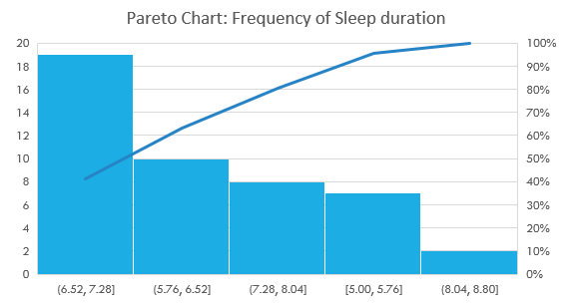
How much sleep, how often?
Pareto chart shows that 41.3% of the time, I slept between 6.52 and 7.28 hours. Not bad, but health experts would say that I’m not getting over 7 hours o sleep often enough. We look to identify which, of the variables for which I was collecting data, have the greatest impact on amount of sleep for the “Control” phase.

Slide 5
Sleep vs Calorie consumption
Plotting calories vs sleep consumption, we see no obvious shape in the scatterplot that would indicate correlation.

Slide 6
Coffee consumption vs productivity
Bad news for the coffee industry: Results of my data collection showed no correlation between coffee consumption and productivity level.

Slide 7
Sleep vs. ounces of coffee consumed
Factors of coffee consumption ranged from 0 through standard cup sizes of 12, 14, 16, and 20 ounces.
We observe a negative linear correlation between coffee consumption and sleep. Not surprising!

Slide 8
Daily calorie intake
Time series plot of my daily calorie intake. I stayed within a range of 2100 and 3100 calories, and was as consistent as I could be.
During weeks 1, 6, and 7, I experimented with a consistent calorie intake on weekdays, similar to the eating regimen of an athlete, consuming the same exact foods weighed out to the gram! Findings on following slide…

Slide 9
Sleep under controlled calorie intake
Week 6 & 7
We observe a positive trend in sleep taking shape when calorie intake is consistent!
Week 1

Slide 10
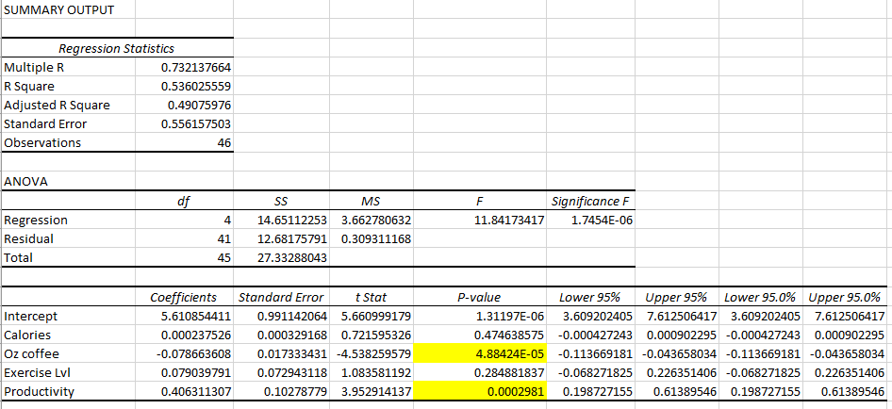
Multiple Regression
The first iteration of my regression model showed that of the four independent variables, coffee consumption and productivity level had the strongest effect on amount of sleep at a significance level of < 0.05.

Slide 11
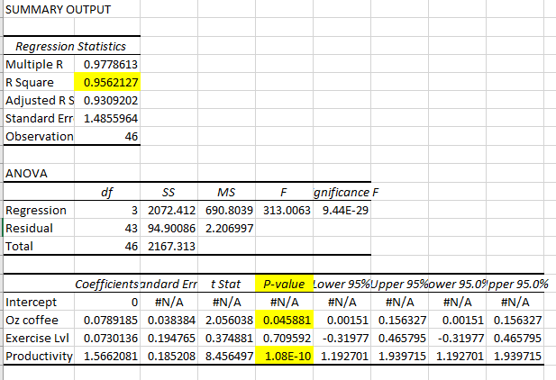
Final regression model
Sleep = 0.079(coffee) + 0.073(exercise) + 1.57(productivity)

Slide 12
Control: What to do now?
The greatest takeaways from this research are that coffee (caffeine) intake has a direct negative correlation to amount of sleep obtained on a given day!
Productivity level is a variable that positively affects quality of sleep. Productivity and daily caffeine intake showed no correlation.
Further controlled studies on exercise and sleep would be beneficial. Identify where possible defects occur in the process.
Perform controlled studies focusing on calorie consumption, as some of the most surprising findings of the whole study were related to consistent calorie consumption and sleep. Does consistent calorie consumption really have a positive correlation with sleep?

